Slide 1
RDF

Slide 2
Why RDF
Why should I use RDF, why not just XML?
How to express following graph
page
Ora
hasAuthor

Slide 3
Why RDF
In RDF, it is trivial (simply a triple):
  triple(page, hasAuthor, Ora)
In XML, there are many ways:
Way1:
<author>
<uri>page</uri>
<name>Ora</name>
</author>
Way2:
<document href="page">
<author>Ora</author>
</document>
Way3:
<document>
<details>
<uri>href="page"</uri>
<author>
<name>Ora</name>
</author>
</details>
</document>
Way4:
<document>
<author>
<uri>href="page"</uri>
<details>
<name>Ora</name>
</details>
</author>
</document>
Way5:
<document href="http://www.w3.org/test/page" author="Ora" />

Slide 4
Why RDF
RDF will provide machine the knowledge tree (semantic graph), where order is not important. – RDF data model is labeled (unordered) graph with two kinds of nodes (resources and literals).
While XML will give a person a document tree where the order or serilaization is important. – XML data model is node-labeled tree (with left-to-right ordered)

Slide 5
What can we use RDF?
Representing information about resources in the WWW
  Describing propoerties for shopping items, such as price and availability
  Describing time schedules for web events
  Describing information about web pages, such as content, author, created and modified date
  Describing content and rating for web pictures
  Describing content for search engines
  Describing electronic libraries

Slide 6
What is RDF
It provides a model for data, and a syntax so that independent parties can exchange and use it.
RDF is designed mainly to be read and understood by computers
RDF is not designed for being displayed to people
RDF is written in XML
  Any XML processor, parsers can parse and process RDF
  The XML language used for RDF is called RDF/XML

Slide 7
RDF – Web standard
RDF became a W3C Recommendation in 2004
A W3C Recommendation is understood by the industry and the Web community as a web standard.
A W3C Recommendation is a stable specification developed by a W3C Working Group and reviewed by the W3C Membership.

Slide 8
RDF and the Semantic Web
RDF is the key part of the Semantic Web activities. It helps to realize the vision of the Semantic Web that:
  Web information should have exact meaning
  Web information can be understood and processed by computers
  Computers can integrate information from the Web

Slide 9
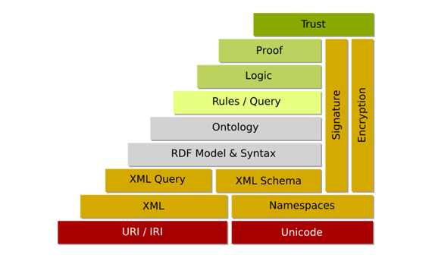
SW Layer Cake

Slide 10
What is RDF?

Slide 11
The relational model
A typical relational database table for books
isbn | title | author | publisherID | pages
0596002637 | Practical RDF | Shelley Powers | 7642 | 350
0596000480 | Javascript | David Flanagan | 3556 | 936
. . . | . . . | . . . | . . . | . . .
. . . | . . . | . . . | . . . | . . .
The rows represent the things you are storing
The columns represent the properties or attributes of those things
The intersection gives the value of that property for that thing
The book has a title with value “Javascript”

Slide 12

The relational model
The book has a title with value “Javascript”

Slide 13
Basic Ideas behind RDF
RDF uses Web identifiers (URIs) to identify resources
RDF describes resources with properties and property values
  Everything can be represented as triples
The essence of RDF is the (s,p,o) triple
Resource
(subject)
Property
(predicate)
Value
(object)
Subject has a property with value “object ” (s,p,o)

Slide 14
RDF Triples
Triple
  A Resource (Subject) is anything that can have a URI: URIs or blank nodes
  A Property (Predicate) is one of the features of the Resource: URIs
  A Property value (Object) is the value of a Property, which can be literal or another resource: URIs, literal, blank nodes
Resource
(subject)
Property
(predicate)
Value
(object)
Literals can be the object of an RDF statement, but cannot be the subject or the predicate

Slide 15
RDF Data Model
Any expression in RDF is a collection of triples (subject, predicate, object)
A set of such triples is called an RDF graph
  The nodes of an RDF graph are its subjects and objects
  The direction of the arc is significant: it always points toward the object.
A assertion of an RDF triple says the relationship (indicated by teh predicate) holds between subject and object.
The meaning of an RDF graph is conjunction (AND) of the statements corresponding to all the triples it contains
RDF does not provide means to express negation (NOT) or disjunction (OR)

Slide 16
RDF design goal
Having a simple data model
Have formal semantics and provable inference
Using an extensible URI-based vocabulary
Using an XML-based syntax
Supporting use of XML Schema datatypes
Allowing anyone to make statements about any resource

Slide 17
More properties
What about showing more properties
isbn | title | author | publisherID | pages
0596002637 | Practical RDF | Shelley Powers | 7642 | 350
0596000480 | Javascript | David Flanagan | 3556 | 936
. . . | . . . | . . . | . . . | . . .
. . . | . . . | . . . | . . . | . . .
Book table

Slide 18
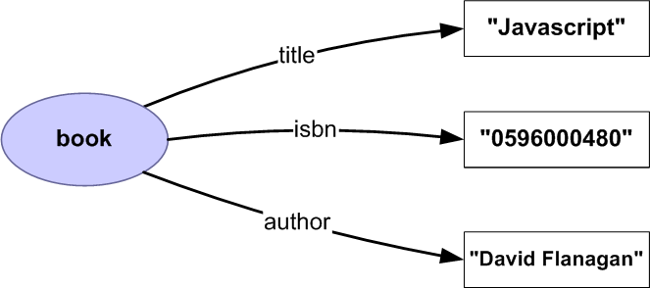
More properties

Slide 19
Relations between entities
Publishers table: publisherID is primary key and exists as foreign key in book table
publisherID | name | . . . | . . .
3556 | O’Reilly | . . . | . . .
7311 | Wrox | . . . | . . .
3209 | Manning | . . . | . . .
. . . | . . . | . . . | . . .

Slide 20
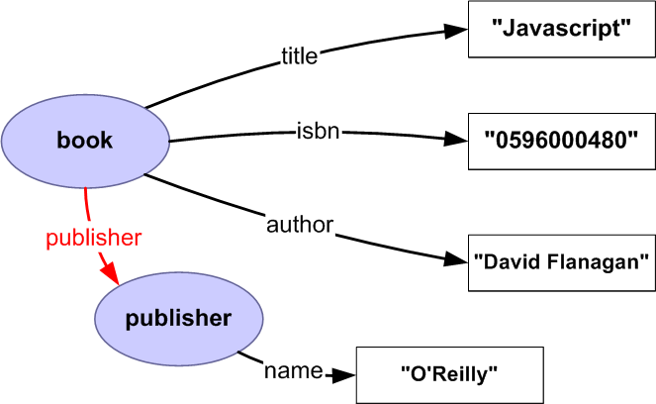
Relations between entities

Slide 21
RDF is a graph
An (s, p, o) triple can be viewed as a labeled graph
The formal semantics of RDF is also described using graphs
Think in terms of graphs, not XML or documents
Nodes in graph are things (resources), arcs are relationship between things (resources)

Slide 22
Datatypes
RDF takes XML Schema Datatypes, such as
  Integer, date, number, …
RDF predefines just one datatype:
  rdf:XMLLiteral: for embedding XML in RDF
RDF provides no mechanism for defining new datatypes
  XML Schema Datatypes provides an extensible framework suitable for defining new datatypes for use in RDF.

Slide 23
URI-based vocabulary and node identification
A node can be
  A node with URI
  A literal, or
  A blank node
URI reference or literal can be used as node identifiers
A blank node has no node identifier (has no name), but
  Convention provides a way to use a blank node identifier to distinguish blank nodes from other nodes.
  When merging different RDF graphs, different blank nodes need to be distinctly identified.

Slide 24
Simple example of RDF
<RDF>
<Description about="http://www.w3schools.com/RDF">
<author>Jan Egil refsnes</author>
<homepage>http://www.w3schools.com</homepage>
</Description>
</RDF>
http://www.w3schools.com/RDF
author
homepage
Jan Egil refsnes
http://www.w3schools.com

Slide 25
RDF Statements
The combination of a Resource, a Property, and a Property value forms a Statement
  A Resource – the subject of a Statement
  A Property – the predicate of a Statement
  A Property value – the object of a Statement

Slide 26
Statement examples
Statement: “The author of http://www.w3schools.com/RDF is Jan Egil Refsnes”
  Subject: http://www.w3schools.com/RDF
  Predicate: author
  Object: Jan Egil Refsnes
Statement: “The homepage of http://www.w3schools.com/RDF is http://www.w3schools.com”
  Subject: http://www.w3schools.com/RDF
  Predicate: homepage
  Object: http://www.w3schools.com

Slide 27
RDF syntax
Starting with <rdf:RDF> and end with </rdf:RDF>
<rdf:Description> is the main element to define the subject, predicate and object of the statement
RDF Namespace
  http://www.w3.org/1999/02/22-rdf-syntax-ns#,
File format: .rdf

Slide 28
RDF Example
<?xml version=“1.0“ encoding=“UTF-8“ ?>
<rdf:RDF xmlns:rdf="http://www.w3.org/1999/02/22-rdf-syntax-ns#"
xmlns:cd="http://www.recshop.fake/cd#">
<rdf:Description
rdf:about="http://www.rechshop.fake/cd/Empire Burlesque">
<cd:artist>Bob Dylan</cd:artist>
<cd:country>USA</cd:country>
<cd:company>Columbia</cd:company>
<cd:price>10.90</cd:price>
<cd:year>1985</cd:year>
</rdf:Description>
<rdf:Description
rdf:about="http://www.rechshop.fake/cd/Hide your heart">
<cd:artist>Bonnie Tyler</cd:artist>
<cd:country>UK</cd:country>
<cd:company>CBS Records</cd:company>
<cd:price>9.90</cd:price>
<cd:year>1988</cd:year>
</rdf:Description>
<!-- more cds -->
</rdf:RDF>

Slide 29
References
RDF tutorial
http://research.talis.com/2005/rdf-intro/
W3C RDF
http://www.w3.org/RDF/
RDF Resource Guide
http://planetrdf.com/guide/

